Slide 1
Session 7

Slide 2
Content of session
01
02
03
Light
Shadows
Timers

Slide 3
01
2D Light

Slide 4
Light
Godot has multiple nodes that allow lighting up your game, with many options and settings.
Among the include:
PointLight2D
DirectionalLight2D
CanvasModulate
And some more nodes are available for shadows.

Slide 5
Light
All Light nodes need Textures (ie. Sprites, Tilemaps) for the light to actually be visible.
So make sure you have your level ready with your map or if you’re working in a scene, the Texture/Sprite is present.

Slide 6

PointLight2D
PointLight2D is used for Light
emanating from sources like
streetlamps, torches, flashlights etc.
You add the node as part of your scene tree, but it won’t appear at first. You need to add a Texture to it.

Slide 7
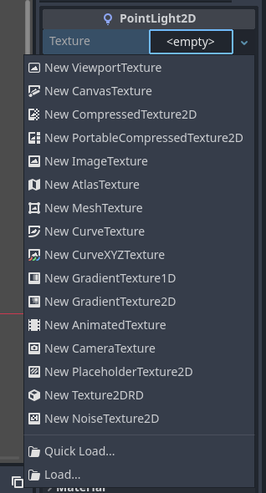
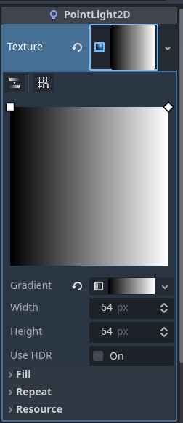
PointLight2D
In the Texture Attribute in the inspector, we’ll choose a new GradientTexture2D.

Slide 8
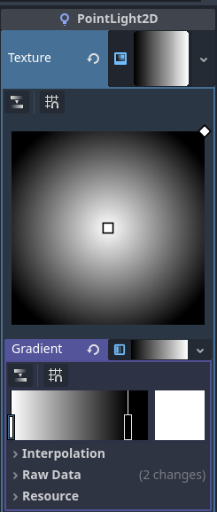
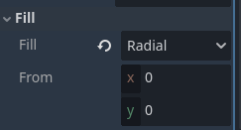
PointLight2D
Then we’ll open up the fill dropdown
menu, and set fill to radial.
Then we’ll open up the gradient resource,
and switch the white and black sliders
to the other side. And we’ll move the
upper left point to the center.

Slide 9
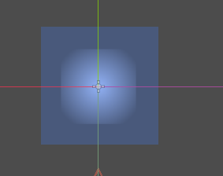
PointLight2D
Now we can see the Light on our project.

Slide 10
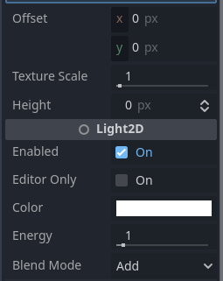
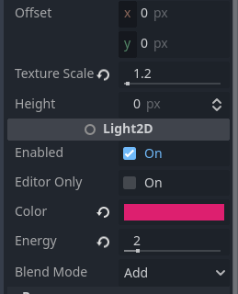
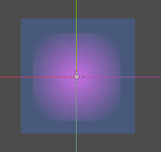
PointLight2D
We can change the Light’s color, it’s intensity (Energy), and it’s size (scale) from the inspector

Slide 11
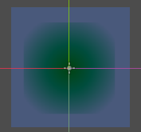

PointLight2D
We can also make the blend mode to be subtractive, and invert the light’s effect.

Slide 12

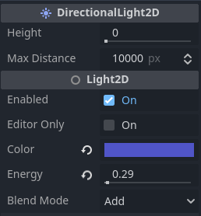
DirectionalLight2D
DirectionalLight2D is a node that affects the whole scene of the game. It has the same effects of the PointLight2D, but without the many settings.
You only configure the light color, it’s intensity and its scale.
You can also configure the Blend mode
to subtract if you want to change the
environment’s tone and mood.

Slide 13
02
Shadows

Slide 14
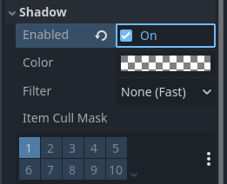
Shadows
Shadows in godot are made available by using occluders.
First off, in our PointLight2D nodes, we need to turn shadows on, so we can actually see shadows interacting with the light source.

Slide 15
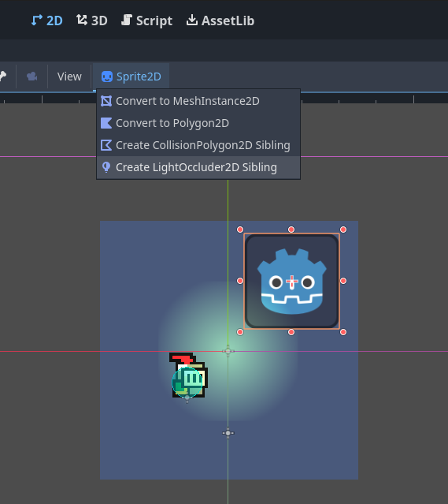
Shadows
For any texture we want to have a shadow, we create a LightOcculder2D sibling to it.
This will generate a new node in our scene tree, with the shape of the texture/sprite.
You can also set occluders for tile map layers.

Slide 16
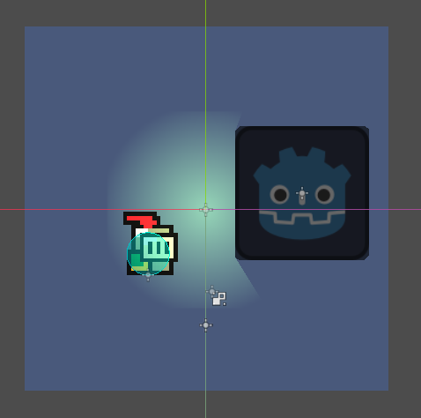
Shadows
Now our object will cast a shadow when the light source is near it!

Slide 17

Shadows
But what if we want to specify certain parts of a texture to have occluders?
We can use the LightOccluder2D node itself.
The LightOccluder2D node allows us to draw shapes for an object and determine where it will cast shadows from.

Slide 18
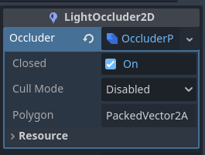
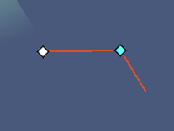
Shadows
In the Inspector, we’ll find the “Occluder” attribute empty. We’ll choose to make a new OccluderPolygon2D resources.
This will allow us to draw any shape we want, and have it cast shadows.

Slide 19
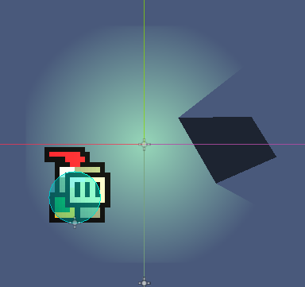
Shadows
We can use this tool to draw shapes in bigger sprites or textures, or if we want to specify specific parts and don’t want the whole texture to become an occluder.

Slide 20
03
Timer

Slide 21
Timer
Many aspects of games have the element of time, be it some sort of countdown, downtime between levels or waves, or maybe an ability’s cooldown.
All these ideas can be implemented in godot using timers.

Slide 22
Timer
Godot has 2 ways it can use timers with
The Timer Node
Directly through GDScript

Slide 23


Timer
The Timer Node is fairly simple. It has “wait time” attribute for how long the timer is, “oneshot” if it repeating or not, and autostart.
There’s also the timeout signal, which is arguably the thing that makes the timer work, as it fires when the timer reaches its end.

Slide 24
Timer
Finally, there’s the GDScript approach, which gets the scene tree, calls the create_timer function and passes it a number of seconds, and will wait it’s timeout signal fires.
We use the await keyword to “wait” for the timeout signal to fire, after that the following code will execute

Slide 25
Thanks!
Any Questions

